Slide 1
Quoptimized:
A More Efficient SQL Query Processor
By: Team QuaHackettes (Ravisara C. & Shasha A.)
Notes:
Data analysis is key to making business decisions in any field. Time is also money, which is why it’s even more important to be able to sort through and analyze data as efficiently and quickly as possible. Ad Hoc OLAP queries are a big part of performing complex analysis on large datasets, helping businesses make data-driven decisions in real time, which is why we’ve created Quoptimized - an OLAP query processing engine that improves the inefficiencies of implementing normal SQL queries.
Today we’ll go over how Quoptimized is different from traditional query processing approaches by making complex query implementation more efficient

Slide 2
Agenda
Motivation
Extended SQL Solution
Architecture of Program
Work Distribution
Phi Query Structure
Tech Stack
Product Limitations
Summary & Future Improvements

Slide 3
Motivation
Aggregation is very important for e.g. statistical databases, business decision making
We need to be able to succinctly express common aggregate queries and for the database to efficiently evaluate these queries
Standard SQL struggles with concise expression of queries with grouping and aggregation over the same groups
Assume we want to find months that were significant for sales of a product. For each product, show the product’s average sales before and after each month.

Slide 4
Motivation
With before(prod, month, avg_x) as (
Select x.prod, x.month, avg(y.quant)
From sales x, sales y
Where x.prod = y.prod and x.month > y.month
Group by x.prod, x.month),
after(prod, month, avg_y) as (
Select x.prod, x.month, avg(y.quant)
From sales x, sales y
Where x.prod = y.prod and x.month < y.month
Group by x.prod, x.month)
Select b.prod, b.month, avg_x, avg_y
From sales s
Left join before b on s.prod = b.prod and s.month = b.month
Left join after a on s.prod = a.prod and s.month = a.month
Long
Multiple scans
Expensive for a query that is conceptually simple
Notes:
Additional joins, correlated subqueries, repeated group-bys
Redundancy
Difficult to write, understand and maintain these queries
Difficult for query optimizer to identify efficient algorithms
Standard SQL can’t efficiently handle multi-layered data aggregation
Joins the same table to itself multiple times to create “with” and “views” which is inefficient
This inefficiency increases makes query analysis slower and increases costs since queries take longer to execute

Slide 5
Extended SQL Solution
Select prod, month, avg(x.quant), avg(y.quant)
From sales
Group by prod, month; x, y
Such that x.prod = prod and x.month < month and
Y.prod = prod and y.month > month
More concise
3 scans
Our solution:
Introduces custom phi operator, grouping variables, MF and EMF queries
Reduces redundancy and improves optimization
Improves ability for database to efficiently evaluate it for optimizations
Notes:
More efficiently handles complex queries and large databases than engines that only use traditional SQL
Streamlines data analysis for businesses
Saves money through the improvement of queries
Easily analyze complex data through the use of Phi operator and grouping variables
Reduce number of scans
No intermediate tables
Easier to read, write, maintain these queries
Easier for query optimizer to identify efficient algorithms
Additionally Quoptimized supports two different kind of grouping analysis through multi feature queries and extended multi feature queries. Multi feature queries enable analysis within a group and extended multi feature queries enable analysis within and outside a group

Slide 6
Quoptimized: How does it work?
Dynamically generates query processing code
Efficiently processes code through the use of:
Phi operator
Grouping variables
Multi-feature queries
Extended multi-feature queries
Shortens the length of queries used in traditional SQL
Notes:
Traditional SQL requires multiple “with” and “view” statements to analyze different groups of data altogether. Through our use of the phi operator and grouping variables we arrange data into groups that streamline the analysis process..

Slide 7
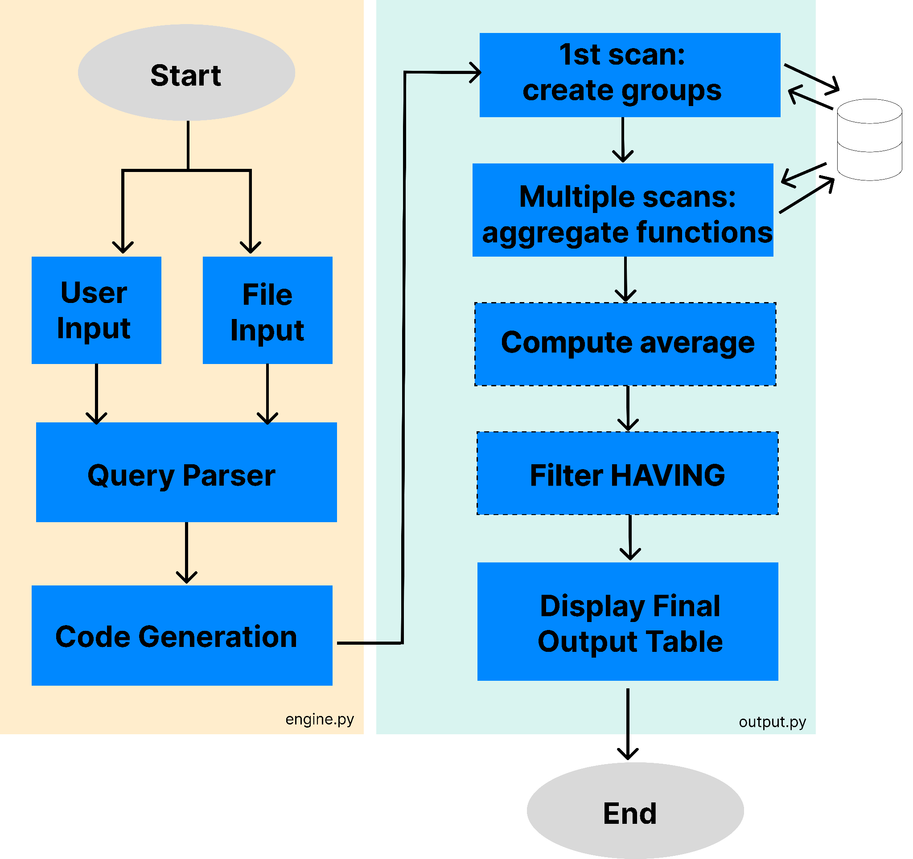
Architecture
Notes:
The architecture overview will help explain how Quoptimized works.
Engine.py is the entry point to the program. It prompts the user for input either as a file or via the command line. The Query Parser acts as a validator. It cleans the input and then parses it into a dictionary of Phi parameters. The code generation step dynamically generates the output query code to output.py. It connects to the database and defines a custom MFStruct class tailored for that query, before generating the code for each of the parameters.
Once output.py is executed, it first scans the database to create the groups based on the grouping attributes. It retrieves the entire dataset and identifies all unique combinations of the grouping attributes. For each unique group, it instantiates an MFStruct object and stores it in a dictionary. Each element in the dictionary is a “row” in the output table.
Then, once we have all the unique groups, for each grouping variable, the program will rescan the database and update the aggregates and then evaluate the predicates for each row. It updates the corresponding aggregate fields within the MFStruct object.
Next, if the query has average or HAVING clause conditions, we calculate that and filter the results.
In the final step, the output table is displayed in the terminal.

Slide 8
Workload Split Between Group Members
Sara
Program architecture/framework
MF structure generation
Phi parameter parsing
Advanced predicate processing
x.state=’CT’ and x.year=’1997’
HAVING clause logic
Created MF/EMF test cases
Shasha:
Input validation
Aggregate parsing
Aggregate calculations
Group creation logic
Base predicate handling
x.state=’CT’
Output table generation
Notes:
Sara
Designed overall program architecture including the HelperFunction and Generator Framework
Implemented MF structure generation
Implemented HAVING clause logic
Built Phi parameter parsing from user input
Developed multi-condition support for each variable in the predicate processing
Created MF/EMF test cases
Shasha:
Implemented user input validation (except for G)
Developed aggregate calculator logic
Implemented group creation logic
Built initial predicate handling for 1 variable (without and or or)
Developed output table generation
Implemented aggregate parsing logic
Created MF/EMF test cases

Slide 9
Input Phi Query Structure
Tech Stack
SELECT ATTRIBUTE(S):
prod, month, avg_1_quant, avg_2_quant
NUMBER OF GROUPING VARIABLES(n):
2
GROUPING ATTRIBUTES(V):
prod, month
F-VECT([F]):
avg_1_quant, avg_2_quant
SELECT CONDITION-VECT([σ]):
1.prod=prod AND 1.month < month
2.prod=prod AND 2.month > month
HAVING_CONDITION(G):
Language: Python3, SQL for testing
Database: PostgreSQL
Packages: psycog2
Notes:
S: Defines projected attributes for output as comma-separated values
n: Specifies the number of grouping variables as a single integer
V: Lists grouping attributes as comma-separated values
[F]: Sets of aggregate functions for each grouping variable as comma-separated values
[σ]: Predicates defining the range for each grouping variable with each variable on a new line
G: Predicate for the having clause as a string
The having condition has been left empty for this particular query
Simple techstack makes it easier and cheaper to maintain
Python3 - Flexibility makes it easy to dynamically create code customized to the user inputs
PostgreSQL - Stores the SQL table the user will be analyzing. In our case it stores the sales.sql table used to demonstrate the query engine
Psycog2 - Establishes the connection with the PostgreSQL database

Slide 10
Limitations of Program
Assumes there are no empty values in the table
Only supports phi input
No support for arithmetic in the select (e.g. month as total percentage of year)
Select does not support: * or AS

Slide 11
Recap & Future Improvements
Standard SQL can become repetitive, difficult to write, and difficult to maintain for complex multi layered aggregates
Quoptimized uses Phi operator and advanced grouping to express OLAP queries more succinctly and efficiently than standard SQL
Incorporating Quoptimized into your business will streamline your analysts workflows saving you time and money
Future Improvements:
Add validation missing columns
Support arithmetic expressions, *, and AS in the SELECT clause

